Slide 1
Why do research?
RIMC Research Capacity Enhancement Workshops Series : “Achieving Research Impact”

Slide 2
Why do research?
To obtain a degree
Satisfy the examiner
To advance an academic career
Publish, Publish, Publish
To influence practice
Multiple forms of communications
To enjoy the lifestyle
To change the world
Some or all of the above
“The mission of our universities needs to include meeting the socioeconomic challenges faced by the world's bottom billions”
Prof. Emeritus Dato' Dr. Zakri Abdul Hamid. Science advisor to the prime minister.

Slide 3
Four of Malaysia's universities have research status
RM100million each
Publications doubled 2007 – 2009
Postgraduate students increase 35%
Universiti Malaya
Universiti Kebangsaan Malaysia
Universiti Putra Malaysia
Universiti Sains Malaysia

Slide 4
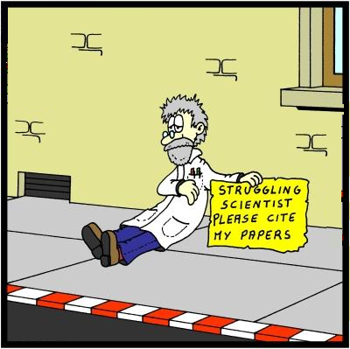
Research and academic careers
Academic careers advance by publications
Research boosts the other components of careers;
teaching, research, managing, writing, networking
The rewards for exceptional teaching rarely match the rewards for exceptional research
Higher education has moved from élite to mass
Academic careers are less secure and more demanding

Slide 5
Research and personal development
Esteem
Travel
Indulge your personal interests and curiosity
Expand your capacity and intellect
Fit into a team and a community
Effort and reward are directly correlated and causal.
If you can get passionate about something, you will do well at it
If personal development is not your primary goal, quality will suffer

Slide 6
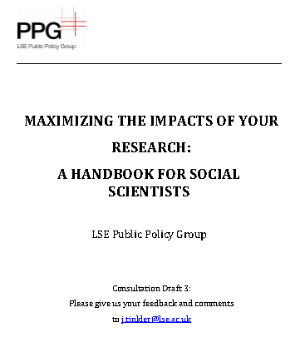
The impact gap
Gap:
Demand and supply mismatches
Insufficient incentives
Poor mutual understanding and communication
Weak social networks and social capital
Tacit knowledge has greater potential for impact but is the most difficult to communicate
Therefore:
Record external impact on your cv
Adopt the principles of customer relationship management
Publish openly
Communicate and network relentlessly
Academic research fails to fulfill its potential to influence wider societal development.

