Slide 1
What is the impact of research?
RIMC Research Capacity Enhancement Workshops Series : “Achieving Research Impact”

Slide 2
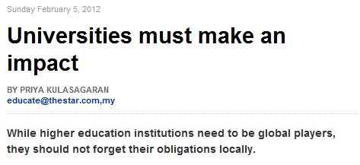
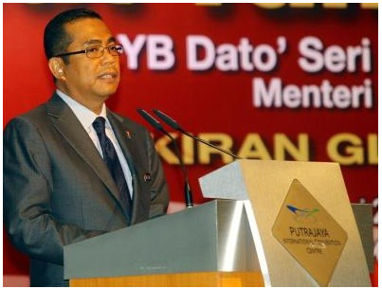
Higher Education Minister Datuk Seri Mohamed Khaled Nordin
Does everyone know what he means by impact?
“Universities should live up to their roles within the local community while making an impact in the international arena.”
Higher Education Minister Datuk Seri Mohamed Khaled Nordin

Slide 3
What is the impact of research?
Research Impacts
Academic Impact
Publications
Citations
Training
Academic Research
Socio-economic Impact
Socio-economic benefits
Public Policy
Capacity building

Slide 4
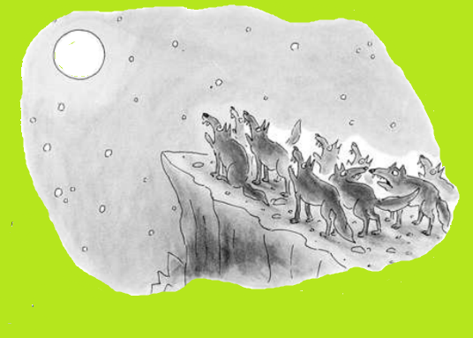
Research Impact
Achieving either type of impact does not automatically lead to achieving the other
There are considerable differences between the processes that lead to each
High quality research is always the starting point for both
Non-academic impacts require more attention than academic
Cross discipline research will better influence wider society
Research Impacts
Academic Impact
Academic Research
Publications
Citations
Training
Socio-economic Impact
Socio-economic benefits
Public Policy
Capacity building
My question is, are we making any impact?

Slide 5
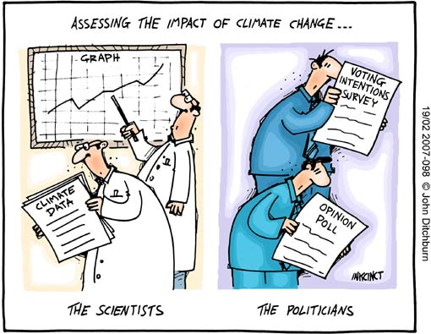
Influencing public policy
Policy making processes are weakly informed by research-based evidence
Policy-makers are influenced by:
their own values, experience, judgment
lobbyists and pressure groups,
pragmatism.
They will take more or less anything that:
can help them to make a decision
seems reasonable
has a clear message
is available at the right time
Researchers:
want everything proven scientifically
need results to be underpinned by theory
wrap their message in caveats and qualifications.
Socio-economic Impact
Public Policy

Slide 6
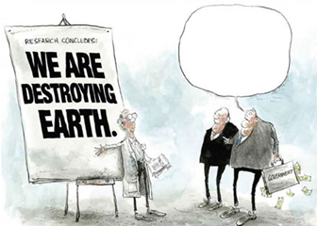
Three domains of the impact of research on public policy
Context
prevailing narratives and discourse among policy-makers
extent of demand for new ideas
political culture and degree of openness
Evidence
research provides a solution to a problem
participatory approaches and pilot schemes
communications and influencing strategy
results packaged in familiar concepts
strenuous advocacy efforts
Links
feedback between researchers and policy-makers
trust, legitimacy, openness and formalisation of networks
Could you kindly rephrase that in equivocal, inaccurate, vague, self-serving and roundabout terms that we can all understand?

Slide 7
Research questions on the domains of the impact of research on public policy
Context
how can contexts be categorised and how best can stakeholders operate to influence policy in different contexts?
how do research–policy processes work in situations with democratic deficits?
what can be done to improve the context for the use of research in policy-making and practice?
Evidence
what institutional characteristics and activities foster research impact on policy?
what advice can be provided on what could work most effectively in different contexts?
Links
how do different types of network and policy research communities influence policy-making ?
do different sorts of policy networks, work better in different environments?
do legitimacy and trust make a difference, and how can they be strengthened?

Slide 8
Key factors shaping the external influence of academic researchers
Academic credibility
Prestigious institutions, publications, citations
Disposition
Desire for impact and research preferences;
Networking skills
The main factor for using research results is knowing that they exist
Personal communication
Public speaking, political sensitivity
Interaction expertise
Engaging with the tacit knowledge of external users
External reputation
Public profile
Experience
Track record

Slide 9
Measuring impact
Traditional assessments focus on publications
Only indicates the intrinsic quality of the research, not its usefulness
Academic publishing Impact Factors are;
“Negotiable
Non-reproducible
Mathematically unsound”
Trend towards evidence-based policy-making increases the demand for ‘evidence’
Extract from an application for an academic job:
Provide a complete list of publications, including original research papers as first author, senior author, impact points total in the last 5 years with marked first and last-authorships, personal Scientific Citations Index (SCI, h-index according to Web of Science) for all publications.
They don’t care what you’ve published, only where.

Slide 10
Citations
Proprietary bibliometric systems for tracking citations:
ISI Web Of Knowledge (Thompson)
Scopus (Elsevier)
Internet-based citation-tracking systems:
Google Scholar (for journal articles and other academic papers)
Google Books
Scirus (Elsevier)
‘Public or Perish’ downloadable software (Prof Harzing)
A book will take longer to be cited but will be cited for longer
Book chapters are often hard to find and are poorly referenced.
Ensure abstracts contain key ‘bottom line’ or ‘take-away points’.
Co-authored outputs generate more citations due to networking effects between authors
The more you publish the more citations you’ll get (=more research & less teaching etc.)
Across all disciplines in the social sciences journal articles account for the majority of citations
Citation measurement
h-score ; ‘5’ means that you have at least five papers which have attracted at least five citations each – favours older researchers with more publications
g-score; variant that favours researchers with a few very highly cited publications

Slide 11
Evidence of impact
All Stages
Research Transfer
Research Outcomes
Research Impact
End-user statements
Third-party surveys, analyses or data
References or citations in policy documents and regulations etc.
Media attention
Presentation invitations
National competitive grants with end-user participation
Cooperative research centre participation in end-user sponsored projects
Supporting testimonials by industry collaboration
Transfer of ownership; e.g. of IP
Licensing arrangements with industry
Independent valuations of spin-off companies or IP packages
Commercial valuations of product sales, processes, savings etc.
Population level outcomes; employment, health etc.
International awards

Slide 12
Evidence-based policy making
Informed by a belief that research will improve policy and practice.
Researchers can enhance their research impact by recognising that:
Publication, even electronically, is not the same as facilitating access;
Dissemination is not the same as reaching your target audience;
Reaching your target audience is not the same as having an impact.

Slide 13
Stages of impact
Traditional Quality Domain
Full Scope of Research Impact
Research Outputs
Discoveries
Publications
Patents
Research Transfer
Engagement with end-users
Research Outcomes
New or improved products or services
Research Impact
Value added improvements achieved
National Benefits
Economic
Licenses
Royalties
Pilots
Prototypes
New products
New services
Start-ups
Joint ventures
Repeat business
Productivity
Cost savings
Competiveness
Employment
Investment
Social
Informing
Government &
industry
Engaging with
community groups
Management
practices
New or improved
Government policy
Savings in natural
resources
Reduced waste
Improved health/well being

Slide 14
eBario impact stages
Traditional Quality Domain
Full Scope of Research Impact
Research Outputs
Publications
Media
Awards
Research Transfer
Engagement with end-users
Research Outcomes
New or improved products or services
Research Impact
Value added improvements achieved
National Benefits
Economic
More tourists
More flights
eBKF
eBario Sdn Bhd
CoERI-ISITI
Radio Bario
Community radio policy
Rural development
Social
DAGS/MoSTI
FORMADAT
National Strategic Framework for Bridging the Digital Divide -> 8&9MP
Knowledge centres

Slide 15
Engaging with end-users
Knowledge Demand
Passive / Latent
Actively requesting
The Knowledge
Attic
An archive in which material
is collected and stored
The Knowledge
Publisher
A system which allows users to request information, but which does not respond with a tailored supply
Passive
Distribute standard
products
Knowledge
Supply
The Knowledge
Pump
A system that tries to deliver
information selectively to people who are believed to need it
The Knowledge
Dialogue
A system which enables users to request information and which responds with a corresponding supply
Active
Distribute customised
products
From: van Heijst, G., van der Spek, R. and Kruizinga, E. (1998) ‘The lessons learned cycle’, in Borghoff, U.M. and Pareschi, R. (eds) Information Technology for Knowledge Management. Berlin: Springer Verlag, pp. 17-34.

Slide 16
Engaging with its end-users
The Knowledge Attic
You may have many publications but are they organised in a single repository. Do you have a Working Paper series or a dedicated journal
The Knowledge Publisher
Do you know who your audience is? Do you engage with them in a way that would facilitate requests for information?
The Knowledge Pump
Do you have a mechanism for discovering the information needs of your audience?
The Knowledge Dialogue
Do you have mechanisms for discovering the information needs of you audience and then supplying them?
Knowledge Demand
Passive / Latent
Actively requesting
The Knowledge
Attic
An archive in which material
is collected and stored
The Knowledge
Publisher
A system which allows users to request information, but which does not respond with a tailored supply
Passive
Distribute standard
products
Knowledge
Supply
The Knowledge
Pump
A system that tries to deliver
information selectively to people who are believed to need it
The Knowledge
Dialogue
A system which enables users to request information and which responds with a corresponding supply
Active
Distribute customised
products

