Slide 1
Publishing Research
RIMC Research Capacity Enhancement Workshops Series : “Achieving Research Impact”

Slide 2
Publishing research; why?
If you don’t publish it, you haven’t done it.
It’s the only form of recognition
Always target the top journals in your field
Develop a pipeline;
Ideas for future development
Research in progress
Conference papers and/or Manuscript drafts
manuscripts under submission
Forthcoming accepted publications
Published work.
Beware of churning / self-plagiarism; 1 project -> 1 (good) paper
Publish in as many formats as possible

Slide 3
Publishing Requirements
Rigour
Research that is conducted according to certain standards and controls appropriate to the methodology.
Relevance
Research that is useful, consumable, readable, meaningful, and value-adding for the journal’s audience.

Slide 4
Tips on pitching a book
Know the market
Make a case for the book’s economic viability
Don't go in cold
Make publishers aware of you before you pitch to them
Don't say your book will be the first of its kind
Sell into established markets
Offer something else
High profile venue for the launch; other events to sell at ; a well-known reviewer; virtual book tour; a video trailer; institutional tie-ins; social media
Think outside the book
Consider going digital/self publishing; faster, cheaper.
Amazon.com sells more Kindle books than print books
Everything
you’ll ever
need to
know about
ICTs for Rural
Development
More of
what you
need to
know about
ICTs for Rural
Development

Slide 5
Digital and Open Publishing
Academic Publishing
(Journals and Books)
Digital
Hard
Copy
Self Publish
Publisher
Paid
Open
Paid
Open
Paid

Slide 6
Open and self publishing
Does not lack intellectual integrity
Self publishing;
Can involve open peer-review
Good for interdisciplinary subjects
Does not contribute to research ratings
Cannot be relied on for career development
Access correlates more closely with impact than peer review does
Hard copy journals;
Long lead time
Expensive
Few readers
Open access journals are gaining reputations
Sites for self publishing books and addressing the ‘long tail’ market;
Unbound
Blurb
Kickstarter
Academic Publishing
(Journals and Books)
Digital
Hard
Copy
Self Publish
Publisher
Open
Paid
Open
Paid
Paid
The Digital Scholar: How Technology Is Transforming Scholarly Practice

Slide 7
The great academic publishing rip-off
Publisher
Taylor & Francis
Sage
Wiley-Blackwell
Macmillan
Article
$36.00
$36.00
$35.00
$30.00
Subscription
$523.00
$1,057.00
$421.00
$400.00
The 3 major publishers earn profit margins of more than 35%
The content is provided free, often from publicly funded research
Even the peer-reviewing is done for free
Sometimes the authors must even pay the publishers
Academic institutions reinforce the existing structure
Universities pay thousands of dollars every year to read their own research online
Publishing in open-access formats could be a career-limiting move for an academic
The first step to increasing the impact of research is to make it more freely available.

Slide 8
ICT4D Journals Ranking

Slide 9
Getting cited in ICT4D
90% of Social Science conference papers are never cited.
The average citation rates in computer science conferences are much higher.
Conference papers should be the lowest priority for getting cited
There are many other good reasons for presenting at conferences
Therefore, publish in the top 3 journals
Citations are a component of academic impact:
Research Impacts
Academic Impact
Academic Research
Publications
Citations
Training
Socio-economic Impact
Socio-economic benefits
Public Policy
Capacity building

Slide 10
Tips for writing manuscripts
Paper Title
Percentage of
Downloads
Number of Words in the Title

Slide 11
Tips for writing manuscripts
The Abstract
Your shop window
Describe the work accurately
Pull out the key points
Include keywords, or synonyms
Should be capable of standing in place of the manuscript
Include summary of conclusions

Slide 12
Tips for writing manuscripts
Paper Length
Less than 10,000 words
All papers
Top 500
Number of
Downloads
Number of Pages

Slide 13
Tips for writing manuscripts
Show your work to others
Write with others
Expect rejections and learn from them
Don’t take criticism personally
Follow good advice
Create your own opportunities;
Propose special issues
Read the journal you want to submit to
Approach editors informally
Respond to Reviewers – point by point in detail

Slide 14
Manuscript Checklist Matkin, R., & Riggar, T. F. (1991) Persist and publish. University Press of Colorado. Table 6.1, p. 82
1. Completeness
goals and objectives are clearly stated
purpose of the article is achieved
ramifications are identified
solutions are presented
presentation of the material is fully logical and coherent
unnecessary information has been removed
information is succinct yet comprehensive
significance of the information is apparent
2. Authoritativeness
references are relevant to the topic
proportional mixture of author and others' works
all relevant sources are cited
occupational disciplinary blinders are removed
authorities from other fields are cited
information is up-to-date
sources of assistance are acknowledged
permission to use others' work is obtained
3. Expertness
proper methodology is used
methodology has been applied appropriately
novel or new methodology is justified
reasons for using previously unused methods are sound
methods are presented clearly
methods can be replicated as identified
purpose is to present method or findings
4. Singularity
provides new information or confirms existing knowledge
unique, original, or new elements are clearly revealed
how old information may be used by others is stated
applicability to salient groups is identified
information that is presented is timely
information is specialized or generalizable
those who could use the information are identified
the article improves the existing body of knowledge
5. Quality
article follows journal guidelines
correct grammar, syntax, spelling, and punctuation are used
non-sexist language is used
ethnic bias is absent
"handicapping" language is absent (e.g., the disabled)
information is presented in an orderly manner
jargon and esoteric terms are absent
communication is parsimonious
article has been proofread
original and copies have a clean appearance

Slide 15
Write only publishing
IGI Global (previously IDEA Group)
Send out form letters to academics inviting them to submit a book/chapter proposal
business model is to sell to university libraries at outrageous prices, e.g., $165.00
Charge authors for copies
Very low citation rate; most of them self-citations
Editors asked the contributors to peer review the other contributions
Require authors to submit a library request form to buy the book
Publish the IRMA International Conference proceedings; 1500+ pages avg 3.8 pagers per paper

Slide 16
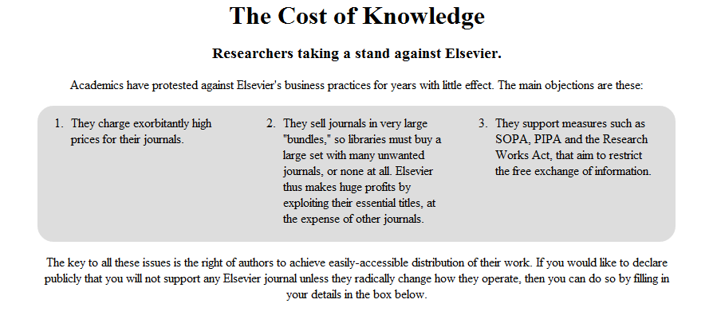
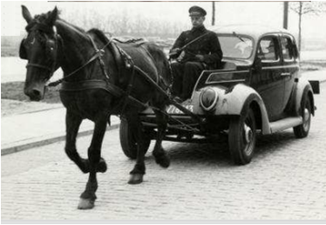
Implications for a university that is contemporary and forward looking
Acknowledge the present system of academic publishing as bankrupt
Consider joining the boycott of Elsevier
Started by a prominent mathematician at Cambridge U
2,900 signatories
Open publishing is growing:
The Federal Research Public Access Act (USA), to broaden open-access for federally funded research; as taxpayers have paid once for the research and shouldn’t have to pay again to read what was done.

