Slide 1
Pathways to Impact: Influencing practice and policy
RIMC Research Capacity Enhancement Workshops Series : “Achieving Research Impact”

Slide 2
Pathways to Impact: Influencing practice and policy
Traditional Quality Domain
Full Scope of Research Impact
Research Outputs
Publications
Media
Awards
Research Transfer
Engagement with end-users
Research Outcomes
New or improved products or services
Research Impact
Value added improvements achieved
National Benefits
Activities that will increase the likelihood of potential economic and societal impacts being achieved
The demonstrable contribution that excellent research makes to society and the economy by:
fostering global economic performance, and competitiveness
increasing the effectiveness of public services and policy
enhancing quality of life, health and creative output.

Slide 3
Impact Activities
Attributes of successful pathways to impact
Commitment for realising both academic and non academic research impacts.
Involvement of users and beneficiaries from outset
Clear understanding of the potential beneficiaries and their needs
Clear mapping of beneficiaries and target audiences
Analysis of demand for research outputs
Strategy for engagement with target audiences
Clear description of milestones and deliverables
Traditional Quality Domain
Full Scope of Research Impact
Research Outputs
Publications
Media
Awards
Research Transfer
Engagement with end-users
Research Outcomes
New or improved products or services
Research Impact
Value added improvements achieved
National Benefits
Impact activities are guided by the answers to two questions:
Who might benefit from the research?
How might they benefit ?
Users And Beneficiaries
Public sector
Policy makers, and their advisers
Commercial private sector
Civil society
The wider public in general.

Slide 4
Types of Impact Activities
Exploiting research findings
Collaborative partnerships, intellectual property protection
Communications and Engagement
Research secondments, special events, workshops, publications, media publicity, websites and interactive media, media relations and public affairs professionals
Capacity and involvement
Who is likely/best able to undertake impact activities?
The researchers
Communication professionals
Technical writers
NGOs
Web page designers
Workshop facilitators
Media specialists
Etc.
What experience do they have?
How will they acquire any additional skills required?
Understand the difference between dissemination and communication
Engaging audiences during research increases the likelihood of the results being used

Slide 5
Impact as a project
Deliverables
Strategic communications
Two-way public engagement activities
Timescales
Milestones
Monitoring
Evaluation
For improvement not judgement
Resources
Knowledge broking/outreach
Consultancy
Publications
Media
Engagements
Networking
Typical Impact Objectives
Raise awareness of an issue within a defined audience
Secure the commitment of a group of stakeholders to the aims of the research
Influence specific policies or policymakers on key aspects of the research
Encourage participation among other researchers or partner bodies

Slide 6
Social media for research impact
Journalists are increasingly relying on social media to source information
blogs, Facebook and Twitter
See ;
Practical tips on how to target Journalists with your research through Twitter
http://www.researchtoaction.org/practical-tips-on-how-to-target-journalists-with-your-research-through-twitter/
Becoming a Networked Researcher – using social media for research and researcher development
http://blogs.lse.ac.uk/impactofsocialsciences/2011/07/07/becoming-a-networked-researcher-using-social-media-for-research/?utm_source=feedburner&utm_medium=feed&utm_campaign=Feed:+r2aresources-web-2-0+(Research+to+Action+Resources:+Web2.0)
Establish your brand/voice/mission
Invite commentary

Slide 7
Policy entrepreneurs
Policy processes
Complex
Mostly non-linear, non-sequential and non-logical
Rarely affected by the presentation of information alone
Rarely impacted directly by research
Involve decision making that is diffuse, and characterized by the progressive establishment of new routines
Involves many actors who interact within an intricate network of communication and exchange
Researchers wishing to maximize the impact of their research on policy and programme formulation in order to inspire and inform policy and practice

Slide 8
Systematic approach to policy entrepreneurship
*
Drivers of change
Power analysis
SWOT
Influence mapping
Force field analysis
Alignment, Interest and Influence Matrix
Stakeholder analysis
Influence mapping
Social network analysis
Force field analysis
Develop a theory of change, with desired behaviour change
Develop a strategy to achieve the milestone changes
Analyse internal capacity and establish an action plan
Establish monitoring and learning system
Map the political context
Identify key stakeholders
Outcome mapping
Journals & impact logs
Define (and re-define) policy objectives
Progress markers
Opportunities and threats timeline
Policy objectives
Alignment, Interest and Influence Matrix
Force field analysis
Policy entrepreneur questionnaire
SWOT
Internal performance frameworks
Force field analysis
Communication strategies
Advocacy campaigns
Network functions approach
Structured innovation
Research strategies
*Overseas Development Institute

Slide 9
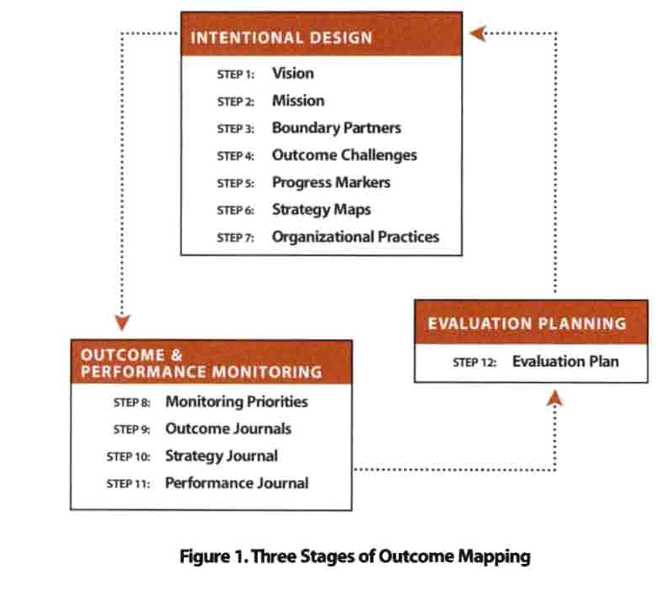
Measuring your influence
Outcome Mapping
Behavioural change:
Outcomes defined as changes in the behaviour, relationships, activities, or actions of the people, groups, and organisations with whom a programme works directly.
Boundary partners:
Individuals, groups, and organisations with whom the programme interacts directly and with whom the programme anticipates opportunities for influence.
Contributions:
Contributions to outcomes, which in turn, enhance the possibility of development impacts – but not necessarily directly causal.
Outcome Mapping: Building Learning and Reflection into Development Programmes, by Sarah Earl, Fred Carden and Terry Smutylo.
INTERNATIONAL DEVELOPMENT RESEARCH CENTRE, 2001

Slide 10
Pathways to Impact Sample Information and Communication Technologies for Indigenised Development:
Build awareness of the project among:
Malaysian policy makers
Malaysian indigenous communities and organisations
International indigenous organisations and forums
Stimulate policy and programme development in Malaysia towards the use of ICTs for indigenised development.
Reduce the digital divide between Malaysia’s indigenous peoples and the rest of society.
Establish CoERI as Asia’s foremost institution for ICTs for indigenised development.
Establish ICTs for indigenised development (ICTID) as a legitimate area of research.
Objectives
ICTs are highly suited to indigenised development.
Indigenous peoples can be facilitated towards designing indigenised development with the help of ICTs.
Malaysian policy should favour indigenised development supported by indigenous peoples’ use of ICTs.
Messages

Slide 11
Pathways to Impact Sample Information and Communication Technologies for Indigenised Development:
Ministry of Information Communications and Culture
Malaysian indigenous peoples organisations
Economic Planning Unit
Ministry of Science, Technology and Innovation
Malaysian Communications and Multimedia Commission
Ministry of Rural and Regional Development
Department of Orang Asli Development
Malaysian State Planning Units; Sarawak, Sabah, Perak, Kelantan.
International Fund for Agricultural Development
UN Permanent Forum on Indigenous Issues
International Work Group for Indigenous Affairs
National and local media
The international ICTD research community
Policy Dialogue Workshops, Project Reports:
For government and indigenous peoples organisations.
National & Local State media:
Articles in newspapers and magazines, video and audio documentary programmes
Project website & Newsletters
All audiences
Conference presentations & Academic publications
Academics
Target Audiences
Engagement activities and
communication channels

Slide 12
Pathways to Impact Sample Information and Communication Technologies for Indigenised Development:
Identity
Branding
Web site development
Internal Communication
Newsletters
Public Engagement Events
Policy Dialogues
Conferences
Media
Media articles
Video documentary
Audio documentary
Publications
Journal publications
Recognisable brand
Operational website
Newsletters published
Dialogues, documented
Conference organised
Articles published
Video broadcast
Audio broadcast
Papers published
Activity
Success Indicator
Qty
Budget
Timeframe

Slide 13
Pathways to Impact Sample Information and Communication Technologies for Indigenised Development:
Objectives
Success Indicator
Build awareness of the project among:
Malaysian policy makers
Malaysian indigenous communities and organisations
International indigenous organisations and forums
Level and number of attendees at events; their feedback.
Number and type of applications to eBario Sdn Bhd for assistance with similar initiatives.
Number of indigenous ICT projects stimulated.
Presentations to international indigenous forums
Stimulate policy and programme development in Malaysia towards the use of ICTs for indigenised development.
Public debate surrounding indigenous ICTs
Policy instruments stimulated
Government programmes for indigenous ICTs influenced
Reduce the digital divide between Malaysia’s indigenous peoples and the rest of society.
Indigenous use of ICTs; number of telecentres, community radio stations etc. in indigenous communities. .
Establish CoERI as Asia’s foremost institution for ICTs for indigenised development.
Number of publications in refereed journals.
Professional training courses offered.
Relevant workshops/conferences organised.
Partnerships and consulting with international organisations.
Book publication by UNIMAS
Establish ICTs for indigenised development (ICTID) as a legitimate area of research.
Increased volume and quality of published research, with citations.

