Slide 1
How to Publish in High Impact Journals
RIMC Research Capacity Enhancement Workshops Series
Dr. Roger W. Harris

Slide 2
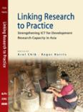
Dr. Roger Harris
Independent Consultant
Major agencies; WB,UN, IDRC, ITU, ADB
Universiti Malaysia Sarawak
Visiting Professor: Institute of Social Informatics and Technological Innovations
Roger Harris Associates
15 Asian countries
Knowledge mobilisation
Funding
Electronic Journal on Information Systems in Developing Countries
Founding Editor
Research
Co-Editor-in-Chief
eBario
Sdn. Bhd.
Director Business Development
Funding
Projects
ICTs for Rural Development and Poverty Alleviation
INFORMATION AND
COMMUNICATION TECHNOLOGIES
FOR
POVERTY ALLEVIATION
Roger W. Harris
http://www.rogharris.org/ roger.harris@rogharris.org

Slide 3
Agenda
Why Researchers Must Write
Journal Impact Factors
How to Choose a Journal
What Editors Look For
How to Structure Your Manuscript
Responding to Reviews

Slide 4
Why Researchers Must Write
To publish your research to bring it to the notice of your peers
To become part of an academic community
To obtain feedback on the quality of:
your research
your writing
To advance your career
To obtain research funding
Writing is a critical skill for academic success

Slide 5
What Purposes do Academic Journals Serve?*
A stamp of quality
To inform and debate
An official record of knowledge and information
A means of managing intellectual property rights and permissions
*Charles Harvey, Aidan Kelly, Huw Morris and Michael Rowlinson, 2010 Academic Journal Quality Guide, The Association of Business Schools, 137 Euston Road, London, NW1 2AA, United Kingdom

Slide 6
What are the Functions of Journal Quality Lists?
Provide an indication of where best to publish.
Inform staffing decisions; appointment, tenure, promotion and reward
Inform library purchasing decisions
Reviews and audits of research activity and the evaluation of research outputs

Slide 7
Types of Journal Quality List
Institutional lists drawn up by members of research groups within a department
Derived lists extrapolate journal rankings from the ratings awarded in assessment or audit activities
Surveys of peers within a particular field or sub-field
Citation studies count the number of times in which an average article in a journal is cited by the authors of articles in related journals
Hybrid lists using a combination of two or more of the above

Slide 8
Commonly Perceived Problems of Journal Quality Lists
Highly rated journals occasionally publish poor pieces of work
High quality research sometimes finds its way into lesser ranked journals.
Normal editorial standards may reduce for special issues
Lists give higher rankings to established journals; newer journals are lower down
Citation impact factors are problematical as a standalone proxy measure of relative journal quality

Slide 9
Limitations of Citation Impact Factors as a Measure of Journal Quality
Incomplete coverage; many journals do not have a citation impact factor
Referential chains; list of references to a series of studies of a similar type that grows longer as more studies of that type are conducted
Herding; tendency of academics to associate their own research through citation to what are perceived to be the best journals and most influential authors
Content bias; Journals devoted to survey articles, literature reviews, methodology and conceptual development tend to be more heavily cited than journals dedicated to publishing the results of original research
Game playing; In less mature fields, referential networks are less dense; citation impact factors are fewer and of a lesser order, and consequently a less valuable guide to the reach and influence of journals in the field.

Slide 10
ABS Specification of Journal Quality Standards
Quality Rating | Meaning of Quality Rating | No. and (%)
4* | World Elite Journals. a small number of grade four journals that are recognized worldwide as exemplars of excellence | 22 (2.7%)
4 | Publish the most original and best executed research. As top journals in their field, these journals typically have high submission and low acceptance rates. Papers are heavily refereed. Top journals generally have the highest citation impact factors within their field. | 72 (8.7%)
3 | Publish original and well executed research papers and are highly regarded. These journals typically have good submission rates and are very selective in what they publish. Papers are heavily refereed. Highly regarded journals generally have fair to good citation impact factors relative to others in their field, although at present not all journals in this category carry a citation impact factor. | 230 (27.9%)
2 | Journals in this category publish original research of an acceptable standard. A well regarded journal in its field, papers are fully refereed according to accepted standards and conventions. Well regarded journals have modest citation impact factors or do not have one at all. | 295 (35.8%)
1 | Publish research of a recognized standard. They are modest standard journals within their field. Papers are refereed relatively lightly according to accepted conventions. Few journals in this category carry a citation impact factor. | 204 (24.8%)

Slide 11
ABS Journal Rankings
No.
N=823
Journal Rank

Slide 12
Subject Fields in ABS Journal Quality Guide
Accounting.
Business History
Economics
Entrepreneurship and Small Business
Ethics and Governance
Finance
General Management
Human Resource Management and Employment Studies.
International Business and Area Studies
Innovation and technology change management
Information Management
Management and Education
Marketing
Organization Studies
Psychology
Operations Research and Management Science
Operations and Technology Management
Public sector policy, management and administration
Sector Studies
Social Sciences
Business Strategy
Tourism and Hospitality Management

Slide 13
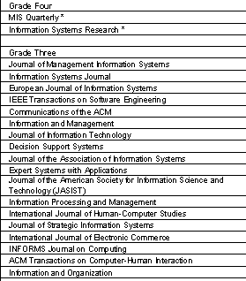
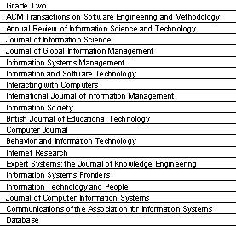
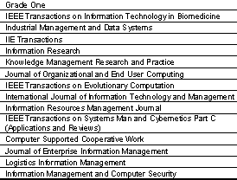
Journal Rankings in Information Management

Slide 14
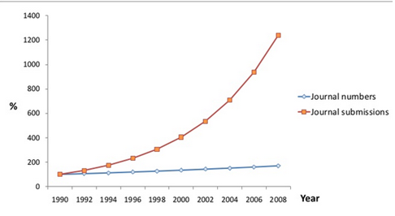
Increasing Competition
Relative growth from 1990 baseline

Slide 15
Today’s Realities
Competitiveness is a priority for universities
Main goals are fundraising and publishing, to achieve high rankings
In almost every academic discipline, publications are the most important and often the only measurable output
Academic career advancement is through publishing as many articles as possible in peer-reviewed scientific journals
But peer-reviewed scientific journals are not all equal

Slide 16
Today’s Realities
There are strict hierarchies among scientific journals that are claimed to represent the average “quality” of the published papers
At the top there are a the A-journals
Next, there the less highly respected B and C journals
The A journals are more difficult to get published in than the B and C journals.

Slide 17
Peer Review
Researchers submit their manuscript to a journal
The editor requests one or more professors (peers) to perform a review, in a ‘double-blind’ procedure
The editors make a decision based on the reviews to;
Publish the manuscript as it is, or
Request some minor revisions from the author, or
Request major revisions and re-submission, or
Reject the manuscript

Slide 18
Peer Review has its Critics
Not transparent; insider procedure
Not demand-driven (e.g. by the public)
Expert judgements are highly subjective
Consensus among experts is usually low
The quality of reviews is highly variable
Plagiarism, fraud and deception are not always discovered
Top-journals reject articles that turn out to be breakthroughs and even won the Nobel Prize.

Slide 19
Gaming the System
Strategic citing;
cite authors who are likely to review your manuscript
avoid criticising authors who are likely to review your manuscript
Support established theories
Most disciplines are dominated by eminent professors who have their ‘pet’ theories
They are also editors of the top journals
New authors are advised to adapt to the prevailing mainstream theories
Value form over content
complex formal models demonstrate technical and mathematical expertise
Overcome anonymity
in practice, anonymity for established researchers is rare
new papers are presented in networks and research seminars, to each other

Slide 20
Group Exercise 1 How might “Gaming the System” damage research?
Authors avoid criticizing the work of possible reviewers
Promotes the replication of established knowledge
Disciplines degenerate into a kind of theology where heresy is not tolerated in established journals.
Promotes censorship, opportunism and adaptation to the mainstream of research.
Discourages originality, favours conformity. Many new ideas do not show up in established journals
Complex formal models move away from reality as false precision is more important than actual relevance
Encourages rivalry

Slide 21
Journal Impact Factors
Research results are reported in academic papers
Academic papers are published in academic journals
Academic journals are classified and ranked by their Impact Factor
A journal's Impact Factor is calculated by dividing the total number of citations its papers received in all journals in any given year by the number of papers it published in the preceding two years
Citations are counted in bibliographic databases
The Impact Factor is widely used to calculate the “quality” of journals.

Slide 22
What is a Citation?
A reference to a published or unpublished source.
An abbreviated alphanumeric expression embedded in the body of an intellectual work that denotes an entry in the bibliographic references section of the work for the purpose of acknowledging the relevance of the works of others to the topic of discussion at the spot where the citation appears.¹
1. http://en.wikipedia.org/wiki/Citation#cite_note-1

Slide 23
All research builds on the work of earlier research.
Academic research papers should describe this previous work; in the literature review.
Citations in academic papers acknowledge this earlier work.
The help you situate your research within the existing body of knowledge.
Help the reader
determine independently whether the referenced material supports the author's argument in the claimed way, and
gauge the strength and validity of the material the author has used
They enable you to describe the contribution of your research to that body of knowledge.
They enable you to avoid accusations of plagiarism.

Slide 24
The science of bibliometrics
Measures and compares the publication output of researchers
Has its own professors and journals
The measurements are becoming more complex and less transparent
Which then in turn justifies more bibliometric research
The most important tool of bibliometric research is citation analysis
The purpose citation analysis is to determine the quantity of citations of the specific journal article to be analyzed
Simple rationale: whoever is often quoted is often read, and what is often read must be of high quality
Hence the quantity of citations can be used as a “quality indicator” of an article
Thus, we obtain an “objective” number for a scientist’s publication output which then can be easily compared and used for rankings.

Slide 25
Impact Factor Example
In 2008 and 2009, Respirology published 364 papers.
In 2010 there were 679 citations to all the papers published in Respirology .
Respirology's Impact Factor for 2011 is therefore for 679 ÷ 364 = 1.865
This means that, on average, recent articles from Respirology have been cited 1.8 times each.

Slide 26
The Impact Factor Debate
Published academic papers ‘inherit’ the Impact Factor of the journal in which they are published.
Although the individual citations that any paper receives can also be counted.
The Impact Factor of a journal can be influenced by a few papers that attract a disproportionately large number of citations, which has the effect of;
understating the impact of the influential paper
overstates the impact of the less influential papers

Slide 27
A Journal can fiddle the game;
Publish its papers early in the year to maximize the time available to cite them;
increase the number of review articles, which are generally cited more often than original articles;
preferentially citing other papers from within the same journal; and
decreasing the time between acceptance of an article and its publication
minimize the number of papers unlikely to be cited after publication.
Journal Impact Factors are therefore increasingly being criticized as an assessment of the quality of an individual's research publications in order to assess their academic performance.

Slide 28
Gaming the System
Salami tactics
New ideas or records are cut as thin as salami slices in order to maximize the number of publications
Present ideas in complex models or approaches in order to fill up an entire article
Publish the same result twice (not recommended)
Increase of the number of authors per article
Today’s average number of authors per article in modern medicine is 4.4, physics 4.1, psychology 2.6
Increase in team research
Professors instruct team members to include them as authors
More ‘phantom authors’; there clinical directors with over 50 publications per year
Self-citations; the more authors, the more who will citing it

Slide 29
Group Exercise 2 What is wrong with the Journal Impact Factor?
The Impact Factor of a journal does not describe the impact, importance or quality of any individual paper
Therefore it is not logically sound to equate the 'impact' of the journal with the 'impact' of each paper in that journal
The calculation process is not transparent
Thomson Scientific has a de facto monopoly for the calculation of impact factors, although the exact calculation is not revealed
It is becoming increasingly difficult to find new and really interesting ideas in the mass of irrelevant publications.
Undervalues research from the global south

Slide 30
Alternatives to the Journal Impact Factor
Computers, the internet and online databases make it easier to generate more meaningful data; using bibliographic databases; e.g:
Web of Science from Thompson Reuters
Scopus from Elsevier
PubMed
Google Scholar
Improve the ability to assign quality and standing to an individual publication and individual researcher
The total number of citations to a paper
The number of weighted citations:
Thomson's Eigenfactor
Elsevier's SCImago Journal Rank
The h-index and the
The immediacy index
Real-time monitoring of article downloads

Slide 31
How to Choose a Journal
Despite its limitations, the system of classifying journals by their Impact Factors is now well established
Journals with higher Impact Factors are better regarded
In most disciplines, there is some consistency about which journals are perceived as being of high impact
E.g.; medical journals, such as the New England Journal of Medicine, The Lancet, the Journal of the American Medical Association, Annals of Internal Medicine are all perceived as having wide readership and high impact, both in terms of citations and in changing clinical practice.

Slide 32
Journal Rankings by Impact Factor
Journal | Impact Factor | RANK (by IF) | Discipline
Nature Reviews Genetics | 41.063 | 1/161 | Genetics & Heredity
Nature | 38.597 | 1/56 | Multidisciplinary Sciences
Molecular Psychiatry | 14.897 | 1/135 | Psychiatry
Cell Death and Disease | 6.044 | 35/184 | Cell Biology
Genetics in Medicine | 5.560 | 20/161 | Genetics & Heredity
Asian Journal of Andrology | 2.14 | 3/6 | Andrology
Scientific American | 1.478 | 15/56 | Multidisciplinary Sciences
Nutrition and Diabetes | 0.818 | 105/121 | Endocrinology & Metabolism

Slide 33
Thomson Reuters Journal Citation Report
Web of Science; “meticulously indexing the most important literature in the world, Web of Science has become the gold standard for research discovery and analytics. ”
“Librarians can support, evaluate and document the value of their library research investments.”
“Publishers can determine journals’ influence in the marketplace, to review editorial policies and strategic direction, monitor competitors, and identify new opportunities.”
“Authors and editors can identify the most appropriate, influential journals in which to publish.”
“Researchers can discover where to find the current reading list in their respective fields.”
“Information analysts and bibliometricians can track bibliometric and citation trends and patterns.”

Slide 34
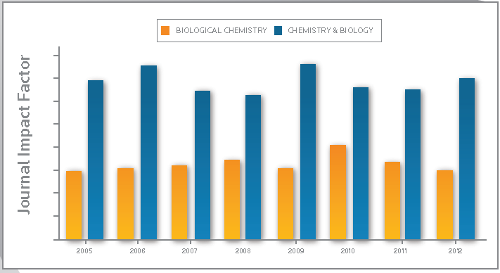
In-depth coverage: You can access close to 12 million articles from over 12,000 journal titles from around the world.
A solid basis for comparison of research performance: Includes baselines, which are the benchmarks for assessing research impact.
Expert guidance that enhances data: Provides editorial comments from scientists and researchers.
Available as a 10-year rolling file: Updated every two months.
JOURNAL CITATION REPORTS COVERAGE
Science edition — over 8,400 leading journals
Social Sciences edition — more than 3,000 leading journals
Covers more than 10,800 journals from over 2,550 publishers in approximately 232 disciplines from 83 countries

Slide 35
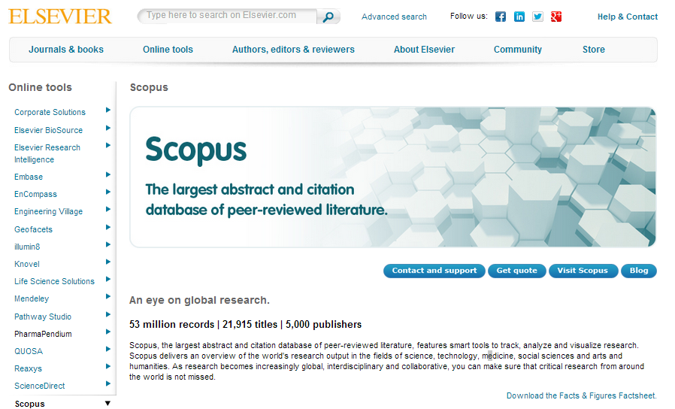
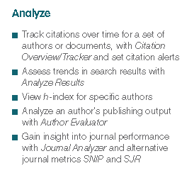
Elsevier: SCOPUS
A bibliographic database containing abstracts and citations for academic journal papers.
Covers ~ 21,000 peer-reviewed titles from 5,000 publishers, scientific, technical, medical, and social sciences (including arts and humanities).
Owned by Elsevier and available online by subscription
http://www.elsevier.com/online-tools/scopus

Slide 36
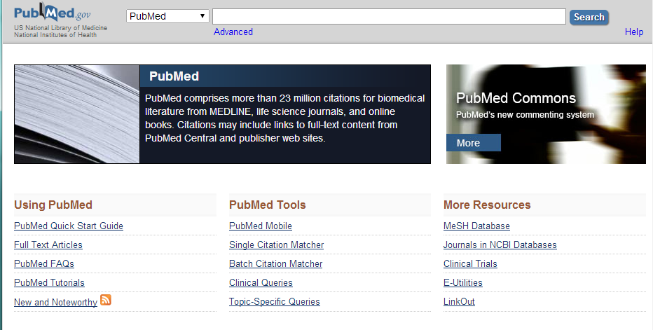
PubMed
PubMed is a free search engine accessing primarily the MEDLINE database of references and abstracts on life sciences and biomedical topics.
The United States National Library of Medicine (NLM) at the National Institutes of Health maintains the database
23 million citations for biomedical literature from MEDLINE, life science journals, and online books.
https://www.ncbi.nlm.nih.gov/pubmed/

Slide 37
Comparisons
PubMed and Google Scholar are free
Scopus offers about 20% more coverage than Web of Science
Google Scholar offers results of inconsistent accuracy.
PubMed remains an optimal tool in biomedical electronic research.
Scopus covers a wider journal range but is limited to recent articles (published after 1995)
WOS database going back to 1945 and Scopus going back to 1966.
Scopus and WOS compliment each others as neither resource is all inclusive
Google Scholar, as for the Web in general, can help in the retrieval of even the most obscure information but its use is marred by inadequate, less often updated, citation information
Scopus is easy to navigate
Scopus offers author profiles which cover affiliations, number of publications and their bibliographic data, references, and details on the number of citations each published document has received.
It has alerting features that allows registered users to track changes to a profile and a facility to calculate authors' h-index
Falagas, ME; Pitsouni, EI; Malietzis, GA; Pappas, G (2008). "Comparison of PubMed, Scopus, Web of Science, and Google Scholar: Strengths and weaknesses". FASEB Journal 22 (2): 338–42. doi:10.1096/fj.07-9492LSF. PMID 17884971.
Burnham, JF (2006). "Scopus database: A review". Biomedical Digital Libraries 3: 1. doi:10.1186/1742-5581-3-1. PMC 1420322. PMID 16522216.

Slide 38
There is always a wide choice of high IF journals to consider when submitting a manuscript
But they are very competitive and the acceptance rate varies between 7% and 25%.

Slide 39
Publishing Requirements
Rigour
Research that is conducted according to certain standards and controls appropriate to the methodology.
Relevance
Research that is useful, consumable, readable, meaningful, and value-adding for the journal’s audience.
Interesting

Slide 40
Length, roughly, 8,000 words:
35.0%
25.0%
15.0%
12.5%
10.0%
2.5%

Slide 41
Sections
Title
Abstract
Introduction
Method
Results
Discussion
Conclusions
References
Appendices

Slide 42
Title
6-10 words; gets more downloads
Simple, attention-grabbing
Authors:
Names
Affiliations
Emails
The lead - corresponding - author first
Abstract
Introduction
Method
Percentage of
Downloads
Results
Discussion
Number of Words in the Title
Conclusions
References
Appendices

Slide 43
Title
Summarizes the entire research paper
Should be capable of standing in its place
Allows a reader to evaluate quickly the content of your paper, and judge if it is relevant to them
Convey a complete synopsis of the paper, but within a word tight limit.
If you are given a maximum word count for an abstract, such as 200 words, stay within it
Papers are generally placed onto a database, with strict limits on the number of words, and an overlong abstract risks the entire paper becoming rejected.
Briefly introduce the general topic
Explain the research question and objectives.
Briefly describe the methodology, results and conclusions
Stick to the research question
Write freely then edit down; cut, cut, cut
Abstract
Introduction
Method
Results
Discussion
Conclusions
References
Appendices

Slide 44
Title
Literature review; start with a broad background/contextual view then narrow it down to your field of study
Explain the rationale behind each step
Focus down to your research problem, thesis and hypothesis
Justify why your work is essential for research in the field. e.g.;
building on previous research,
looking at something that everybody else has overlooked,
Improving on previous research that delivered unclear results
Assume that your paper will be read by someone with a good working knowledge of your field
Explain how you are going to fill the knowledge gap, laying out your objectives and methodology
Alert the reader to any weaknesses and assumptions
Define the problem
Ensure your discussion and conclusion refer back to this
Abstract
Introduction
Method
Results
Discussion
Conclusions
References
Appendices

Slide 45
Title
Writing the methodology lies at the core of the paper, and fulfills one of the basic principles underlying the scientific method.
Scientific research needs to be verifiable by other researchers, so that they can review the results by replicating the experiment and corroborate its validity
Needs an accurate description of the equipment and techniques used to gather data
Explain how the raw data was compiled and analyzed
Allows readers to evaluate the results and judge the validity of your conclusions
There are variations according to the type of research, the methodology can be divided into a few sections:
Describe the materials and equipment
Explain how samples were gathered
Explain how measurements were made
Describe the calculations that were performed on the data
Describe the statistical techniques used
Write in chronological order, using the past tense
Abstract
Introduction
Method
Results
Discussion
Conclusions
References
Appendices

Slide 46
Title
Straightforward commentary of what you observed and found
No interpretation or evaluation
Avoid excessive information that obscures your key findings
Don’t repeat; e.g., use tables or graphs, not both. If data is in a table, don’t repeat it in the text
Display the most relevant information in the graph, figures and tables.
Use the text to direct the reader to these, and to link to the discussion section, e.g., highlighting correlations and key findings.
Include negative results; excluding them invalidates the paper and is bad science
Negative results, and how you handle them, often lead to an interesting discussion section
Use an appendix for larger amounts of raw data and/or calculations
Specify any computer programmes that you used
Assume the reader understands basic statistical tests
Abstract
Introduction
Method
Results
Discussion
Conclusions
References
Appendices

Slide 47
Title
Where you add your interpretations to the findings
Explain any links and correlations in your data
Build on the links you left in the results section
Some speculation is allowed, e.g., regarding causality
Address your null or alternative hypotheses according to the significance levels found by the statistics
Explain the statistical results in the context of your enquiry
Discuss what you did not find, and how you deal with that.
Even if the results are inconclusive (probable), try to find something of value
Position your findings into the context of previous research; do they concur or contradict or add something new
Suggest where results of previous research might help to interpret your own findings
Explain if and how your research has contributed to knowledge, or not
Reflect on the research design in the light of the outcomes;
What might you have done differently
What modifications and improvements would you suggest to another researcher
Avoid sweeping generalizations in the applicability of your findings to the wider world
Abstract
Introduction
Method
Results
Discussion
Conclusions
References
Appendices

Slide 48
Title
Writing a conclusion is the final part of the research paper, drawing everything together and tying it into your initial research question. Answer the research question here
Provide a short synopsis of the results and discussion, summing up the paper
Explain the extent to which the results have provided an answer to the research question.
Specify some questions that another researcher can expand upon for their research
Explain the importance of the study and point out how it relates to the field
Blend your findings into the body of research highlighted in the introduction
Describe how your findings can be used by readers, pointing out the benefits
Propose the practical significance of your findings for professional practice/policy making /commercial and managerial etc.
State what was learned
Highlight any deficiencies
Bring out any unanswered questions
Offer suggestions for future research
Abstract
Introduction
Method
Results
Discussion
Conclusions
References
Appendices

Slide 49
Title
Prevent accusations of plagiarism and to give fair credit to the work of previous authors
Substantiates your literature review
Reviewers and experienced researchers often look at the references first to see if the right ones are there
Follow the style of the journal to which you are submitting and be consistent
Ensure every reference is cited in the text
Ensure every citation in the text is referenced
Guide to Citation Style Guides http://bailiwick.lib.uiowa.edu/journalism/cite.html
Abstract
Introduction
Method
Results
Discussion
Conclusions
References
Appendices

Slide 50
Title
Useful way to include information that would otherwise clutter up the paper
Usually non-essential; if removed, the paper would still be perfectly understandable
Place for raw data, questionnaire, statistical calculations, maps, extra photographs and diagrams of apparatus, abbreviations
Does not count towards the word count
Creates a good impression with attention to detail
Abstract
Introduction
Method
Results
Discussion
Conclusions
References
Appendices

Slide 51
Before submitting…
Proof read,
Proof read, again, &
Proof read yet again
Then format

Slide 52
What editors don’t like:
Unclear objectives; too many, over- ambitious, un-focused
Incomplete/overdone literature review; not critically evaluated
Conclusions that do not arise from the discussion
No data, no research, failure to address objectives
Excessive speculation; failing to follow the evidence
Confusing correlation with causation
Unsuitable length; should be 5-8k words
No story; uninteresting, boring
Trivial, irrelevant, no problem, done before
Poorly constructed, weakly argued
Ethical concerns; previously published, submitted elsewhere

Slide 53
Responding to reviews
Tell the reviewer(s) what you have done
List their comments on a separate document
Against each, explain your response;
Agree; how you have changed your manuscript
Disagree; justify
Reconcile conflicting reviews
Always remember;
It’s your work
Peer reviewing is an art not a science

Slide 54
Papers that high-impact journals publish
Address a challenging problem whose solution has considerable impact on the discipline
Demonstrate considerable familiarity with the topic and its literature
Express the problem with mathematical modelling, visualization, or empirical experiment
Well written: complete; good use of English; clear formatting; high-quality graphics
Strictly adhere to the standards of research in the discipline
Develop an innovative solution
Discover something new, counter-intuitive or controversial
Work at the state-of-the-art in the discipline

Slide 55
Getting it published
Select your journal carefully
Be careful to follow the instructions for authors
Focus the article on one finding
Prepare one figure that shows or illustrates the main main finding
Explain your new finding in the abstract, the discussion AND the conclusions
Delete any irrelevant results or those that are not explained
Distinguish clearly between the results from your study and those of others
Include a good dose of education and dissemination
Read your article at least five times before submitting it
make sure your manuscript is written in good English
Scientific Writing for Impact Factor Journalsby Eric Lichtfouse
ISBN-13: 978-1626189430 ISBN-10: 1626189439

Slide 56
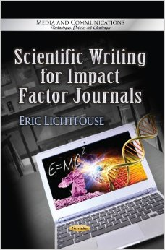
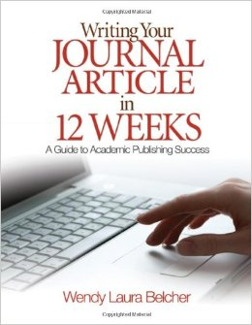
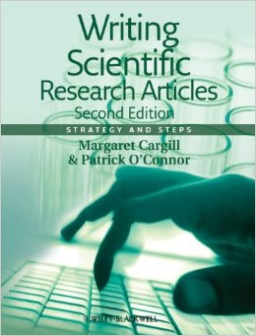
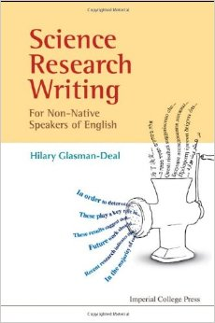
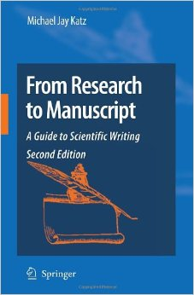
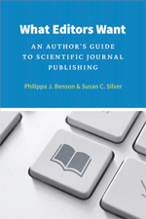
Scientific Writing for Impact Factor Journals Paperback By Eric Lichtfouse
Writing Your Journal Article in Twelve Weeks: A Guide to Academic Publishing Success by Wendy Laura Belcher
Writing Scientific Research Articles: Strategy and Steps Paperback
by Margaret Cargill , Patrick O'Connor
Science Research Writing: A Guide for Non-Native Speakers of English
by Hilary Glasman-Deal
What Editors Want. An Author's Guide to Scientific Journal Publishing
By Philippa J. Benson and Susan C. Silver
From Research to Manuscript: A Guide to Scientific Writing
by Michael Jay Katz

Slide 57
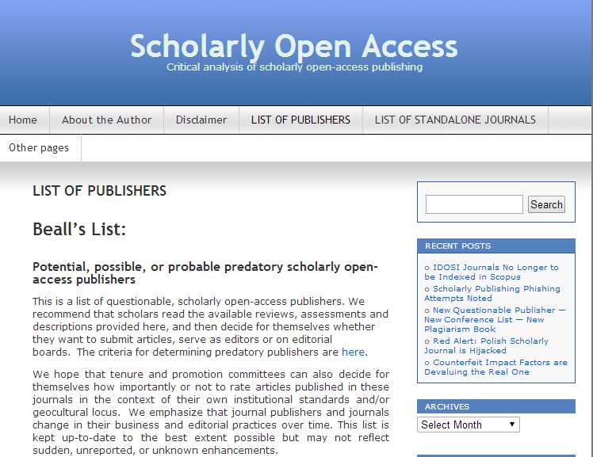
Beware Predatory Publishers
http://scholarlyoa.com/publishers/

