Slide 1
Literature Review
Dr. Roger Harris
Visiting Professor
Institute of Social Informatics and Technological Innovation
roger.harris@rogharris.org
http://www.rogharris.org/
@HarrisrwhRoger
May 2nd 2013

Slide 2
What?
What is “Literature”?
Scholarly articles, books and other sources (e.g. dissertations, conference proceedings) relevant to a particular issue, area of research, or theory, providing a description, summary, and critical evaluation of each work.
What is a Literature Review?
An account of what has been published on a topic by accredited scholars and researchers.
An evaluative report of information found in the literature related to your selected area of study.
Summary, classification, and comparison of prior research studies, reviews of literature, and theoretical articles

Slide 3
Why do researchers need to conduct literature reviews?
To develop an overview of significant literature published on a topic.
To prepare part of the introduction to an essay, research report, or thesis.
To convey to your reader what knowledge and ideas have been established on a topic, and what their strengths and weaknesses are.
To enable you to gain and demonstrate skills in two areas;
information seeking: the ability to scan the literature efficiently, using manual or computerized methods, to identify a set of useful articles and books
critical appraisal: the ability to apply principles of analysis to identify unbiased and valid studies.

Slide 4
What does a literature review do?
Enlarging your knowledge about the topic
Convey to the reader what knowledge and ideas have been established on a topic, and what their strengths and weaknesses are .
Synthesize the results into a summary of what is known and what is not known
Identify gaps in the literature
Identify areas of controversy and disagreement
Formulate questions that need further research
Identify and describe existing theories in the field
Narrow down your field of enquiry towards a doable research study.
Justify your project.

Slide 5
What must a literature review be?
The start of the research preparation.
One of the early tasks that research students undertake.
Organized around and related directly to the thesis or research question you are developing.
Defined by a guiding concept (e.g., your research objective, the problem or issue you are discussing, or your argumentative thesis).
It is not just a descriptive list of the material available, or a set of summaries.
The theoretical base for your research which will determine the nature of your research.
A self-contained manuscript as an end in itself or a preface to and rationale for engaging in primary research
Part of grant and research proposals
A chapter in your thesis and dissertation.

Slide 6
What should a literature review contain?
An overview of the subject, issue or theory under consideration, along with the objectives of the literature review
Division of works under review into categories (e.g. those in support of a particular position, those against, and those offering alternative theses entirely)
Explanation of how each work is similar to and how it varies from the others
Conclusions as to which pieces are best considered in their argument, are most convincing of their opinions, and make the greatest contribution to the understanding and development of their area of research

Slide 7
Assessing the literature to examine:
Provenance—What are the author's credentials? Are the author's arguments supported by evidence (e.g. primary historical material, case studies, narratives, statistics, recent scientific findings)?
Objectivity—Is the author's perspective even-handed or prejudicial? Is contrary data considered or is certain pertinent information ignored to prove the author's point?
Persuasiveness—Which of the author's theses are most/least convincing?
Value—Are the author's arguments and conclusions convincing? Does the work ultimately contribute in any significant way to an understanding of the subject?

Slide 8
How to conduct a literature review
Problem formulation —which topic or field is being examined and what are its component issues?
Literature search —finding materials relevant to the subject being explored.
Data evaluation —determining which literature makes a significant contribution to the understanding of the topic.
Analysis and interpretation —discussing the findings and conclusions of pertinent literature.

Slide 9
How to conduct a literature review
Familiarize yourself with the scholarly journal literature by browsing the Library's journals lists.
Identify the keywords and phrases that describe your topic by making a list of possible synonyms.
Select and search appropriate databases or search tools, for example:
Academic Search Premier (Multidisciplinary)
LexisNexis Academic (Current News)
Expanded Academic ASAP (Multidisciplinary)
ERIC (Scholarly and practical education literature)
Education Full Text(Scholarly education literature)
Social Sciences Citation Index (Citation tracking)

Slide 10
How to write a literature review
The format of a review of literature may vary from discipline to discipline and from assignment to assignment.
Write it as a piece of discursive prose (proceeding by reasoning or argument rather than intuition) not a list describing or summarizing one piece of literature after another.
Organize the review into sections that present themes or identify trends and relevant theories.
Don’t start every paragraph with the name of a researcher.
Do not list all the material published, but synthesize and evaluate it according to the guiding concept of your thesis or research question.

Slide 11
Writing the introduction
Define or identify the general topic, issue, or area of concern, thus providing an appropriate context for reviewing the literature.
Point out overall trends in what has been published about the topic; or conflicts in theory, methodology, evidence, and conclusions; or gaps in research and scholarship; or a single problem or new perspective of immediate interest.
Establish the writer's reason (point of view) for reviewing the literature; explain the criteria to be used in analyzing and comparing literature and the organization of the review (sequence); and, when necessary, state why certain literature is or is not included (scope).

Slide 12
Writing the body
Group research studies and other types of literature (reviews, theoretical articles, case studies, etc.) according to common denominators such as qualitative versus quantitative approaches, conclusions of authors, specific purpose or objective, chronology, etc.
Summarize individual studies or articles with as much or as little detail as each merits according to its comparative importance in the literature,.
Provide the reader with brief "so what" summary sentences at intermediate points in the review to aid in understanding comparisons and analyses.

Slide 13
Writing the conclusion
Summarize major contributions of significant studies and articles to the body of knowledge under review, maintaining the focus established in the introduction.
Evaluate the current "state of the art" for the body of knowledge reviewed, pointing out major methodological flaws or gaps in research, inconsistencies in theory and findings, and areas or issues pertinent to future study.
Conclude by providing some insight into the relationship between the central topic of the literature review and a larger area of study such as a discipline, a scientific endeavor, or a profession.

Slide 14
Ask yourself:
What is the specific thesis, problem, or research question that my literature review helps to define?
What type of literature review am I conducting? Am I looking at issues of theory? methodology? policy? quantitative research? qualitative research?
What is the scope of my literature review? What types of publications am I using (e.g., journals, books, government documents, popular media)? What discipline am I working in (e.g., nursing psychology, sociology, medicine)?
How good was my information seeking? Has my search been wide enough to ensure I've found all the relevant material? Has it been narrow enough to exclude irrelevant material? Is the number of sources I've used appropriate for the length of my paper?
Have I critically analysed the literature I use? Do I follow through a set of concepts and questions, comparing items to each other in the ways they deal with them? Instead of just listing and summarizing items, do I assess them, discussing strengths and weaknesses?
Have I cited and discussed studies contrary to my perspective?
Will the reader find my literature review relevant, appropriate, and useful?

Slide 15
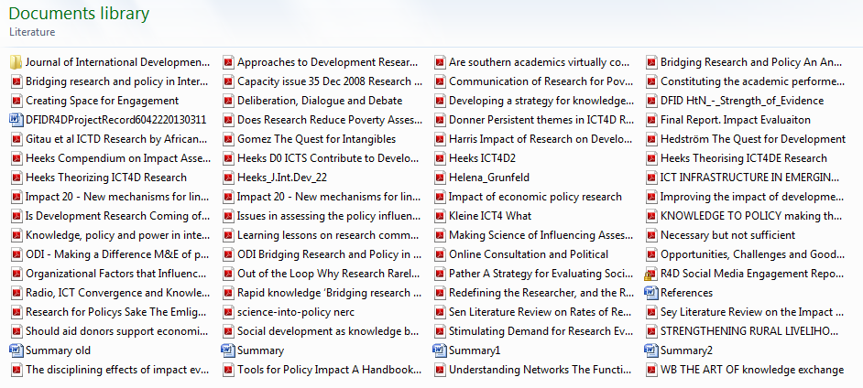
Tip; collecting literature
A folder with your collection of pdf documents that are searchable

Slide 16
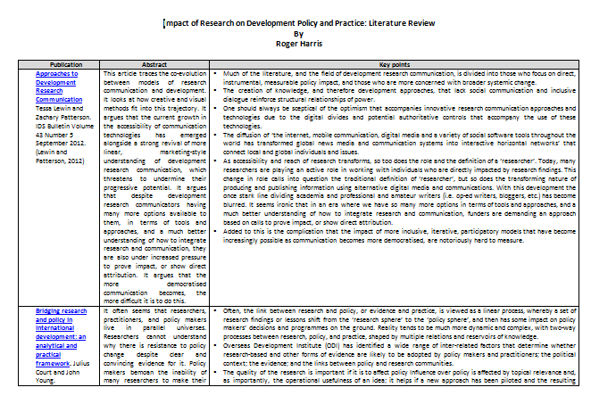
Tip; summarising literature
A searchable word document where you collect the abstracts and key points of each document in the collection that are relevant to your research enquiry. The titles are linked to the document to make them easy to open for closer examination.

Slide 17
The Impact of Research on Development Policy and Practice: This much we know. A Literature Review and the Implications for ICT4D
Introduction
Purpose of the review
Opposing Perspectives
Two Communities
What is Impact?
Thematic Overview of the literature
Intent
Communication
Information and Communication Technologies
Intermediaries
Policy Entrepreneurs
Networks
Incentives
Political Context
Demand
Engagement
Summary
Implications for ICT4D research
Conclusions
References

Slide 18
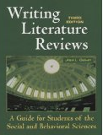
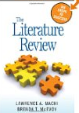
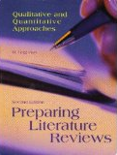
There are plenty of books on the subject

