Slide 1
Publishing Research
Prof. Dr. Roger W. Harris

Slide 2
Agenda
How to write an academic paper.
Structuring manuscripts correctly.
What to include.
The peer-review process.
What reviewers look for.
Identifying journals to submit to.
Writing skills.
Organizing references.
Common mistakes.
Plagiarism.

Slide 3
Publishing research; why?
If you don’t publish it, you haven’t done it.
It’s the only form of recognition
Always target the top journals in your field
Develop a pipeline;
Ideas for future development
Research in progress
Conference papers and/or Manuscript drafts
manuscripts under submission
Forthcoming accepted publications
Published work.
Beware of churning / self-plagiarism; 1 project -> 1 (good) paper
Publish in as many formats as possible

Slide 4
Publishing Requirements
Rigour
Research that is conducted according to certain standards and controls appropriate to the methodology.
Relevance
Research that is useful, consumable, readable, meaningful, and value-adding for the journal’s audience.

Slide 5
How to write an academic paper
Structuring manuscripts correctly
What to include

Slide 6
Length, roughly
 | No of Words | %
Abstract | 200 | 2.5%
Introduction | 2800 | 35.0%
Method | 2000 | 25.0%
Results and Discussion | 1200 | 15.0%
Conclusions | 1000 | 12.5%
References | 800 | 10.0%
 | 8000 | 100.0%

Slide 7
Sections
Title
Abstract
Introduction
Method
Results
Discussion
Conclusions
References
Appendices

Slide 8
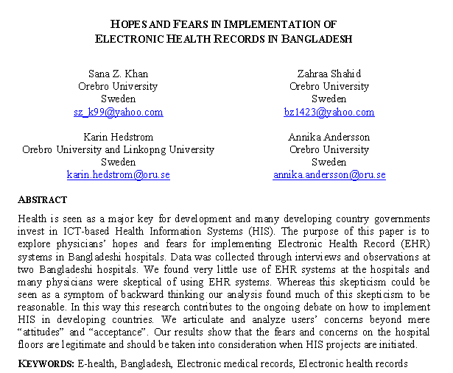
6-10 words; gets more downloads
Simple, attention-grabbing
Authors
Names
Affiliations
Emails
The lead author first
Title
Abstract
Percentage of
Downloads
Introduction
Method
Results
Number of Words in the Title
Discussion
Conclusions
References
Appendices

Slide 9
Acknowledgements
Polite gesture to thank the people who helped you with the research, without falling under the category of citations.
Some funders insist on it
Sometimes at the beginning after the abstract, or at the end in an appendix
No standard format

Slide 10
Summarizes the entire research paper
Should be capable of standing in its place
Allows a reader to evaluate quickly the content of your paper, and judge if it is relevant to them
Convey a complete synopsis of the paper, but within a word tight limit.
If you are given a maximum word count for an abstract, such as 200 words, stay within it
Papers are generally placed onto a database, with strict limits on the number of words, and an overlong abstract risks the entire paper becoming rejected.
Briefly introduce the general topic
Explain the research question and objectives.
Briefly describe the methodology, results and conclusions
Stick to the research question
Write freely then edit down; cut, cut, cut
Title
Abstract
Introduction
Method
Results
Discussion
Conclusions
References
Appendices

Slide 11
Literature review; start with a broad background/contextual view then narrow it down to your field of study
Explain the rationale behind each step
Focus down to your research problem, thesis and hypothesis
Justify why your work is essential for research in the field. e.g.;
building on previous research,
looking at something that everybody else has overlooked, or
Improving on previous research that delivered unclear results
No strict word limit, but be concise
Assume that your paper will be read by someone with a good working knowledge of your field
Explain how you are going to fill the knowledge gap, laying out your objectives and methodology
Alert the reader to any weaknesses and assumptions
Keep it Short
Define the Problem
Ensure your discussion and conclusion refer back to this
Title
Abstract
Introduction
Method
Results
Discussion
Conclusions
References
Appendices

Slide 12
Common problems with literature reviews
Lack organization and structure
Lack focus, unity and coherence
Repetitive and verbose
Fail to cite influential papers
Fail to keep up with recent developments
Fail to critically evaluate cited papers
Cite irrelevant or trivial references
Depend too much on secondary sources

Slide 13
Writing the methodology lies at the core of the paper, and fulfills one of the basic principles underlying the scientific method.
Scientific research needs to be verifiable by other researchers, so that they can review the results by replicating the experiment and corroborate its validity
To enable this, you need an accurate description of the equipment and techniques used to gather data
Explain how the raw data was compiled and analyzed
Allows readers to evaluate the results and judge the validity of your conclusions
There are variations according to the type of research, the methodology can be divided into a few sections:
Describe the materials and equipment
Explain how samples were gathered
Explain how measurements were made
Describe the calculations that were performed on the data
Describe the statistical techniques used
Write in chronological order, using the past tense
Title
Abstract
Introduction
Method
Results
Discussion
Conclusions
References
Appendices

Slide 14
A straightforward commentary of exactly what you observed and found
No interpretation or evaluation
Avoid excessive information that obscures your key findings
Don’t repeat; e.g., use tables or graphs, not both. If data is in a table, don’t repeat it in the text
Display the most relevant information in the graph, figures and tables.
Use the text to direct the reader to these, and to link to the discussion section, e.g., highlighting correlations and key findings.
Include negative results; excluding them invalidates the paper and is bad science
Negative results, and how you handle them, often lead to an interesting discussion section
Use an appendix for larger amounts of raw data and/or calculations
Specify any computer programmes that you used
Assume the reader understands basic statistical tests
Title
Abstract
Introduction
Method
Results
Discussion
Conclusions
References
Appendices

Slide 15
Where you add your interpretations to the findings
Explain any links and correlations in your data
Build on the links you left in the results section
Some speculation is allowed, e.g., regarding causality
Address your null or alternative hypotheses according to the significance levels found by the statistics
Explain the statistical results in the context of your enquiry
Discuss what you did not find, and how you deal with that.
Even if the results are inconclusive (probable), try to find something of value
Position your findings into the context of previous research; do they concur or contradict or add something new
Suggest where results of previous research might help to interpret your own findings
Explain if and how your research has contributed to knowledge, or not
Reflect on the research design in the light of the outcomes;
What might you have done differently
What modifications and improvements would you suggest to another researcher
Avoid sweeping generalizations in the applicability of your findings to the wider world
Title
Abstract
Introduction
Method
Results
Discussion
Conclusions
References
Appendices

Slide 16
Writing a conclusion is the final part of the research paper, drawing everything together and tying it into your initial research. Answer the research question here
Explain the extent to which the results have provided an answer to the research question.
Specify some questions that another researcher can expand upon for their research
Provide a short synopsis of the results and discussion, summing up the paper
Mainly acts as an aid to memory
Blend your findings into the body of research highlighted in the introduction
Explain the importance of the study and point out how it relates to the field
Describe how your findings can be used by readers, pointing out the benefits
Propose the practical significance of your findings for professional practice/policy making /commercial and managerial etc.
State what was learned
Highlight any deficiencies
Bring out any unanswered questions
Offer suggestions for future research
Title
Abstract
Introduction
Method
Results
Discussion
Conclusions
References
Appendices

Slide 17
Prevent accusations of plagiarism and to give fair credit to the work of previous authors in the field
Substantiates your literature review
Reviewers and experienced researchers often look at the references first to see if the right ones are there
Follow the style of the journal to which you are submitting and be consistent
Ensure every reference is cited in the text
Ensure every citation in the text is referenced
Guide to Citation Style Guides http://bailiwick.lib.uiowa.edu/journalism/cite.html
Title
Abstract
Introduction
Method
Results
Discussion
Conclusions
References
Appendices

Slide 18
APA Citations
Citation in text
Reference
As Richards (2004) says, ICTs represent a crucial force for cultural change.
Richards C. (2004) From Old to New Learning: Global Imperatives, Exemplary Asian Dilemmas and ICT as a Key to Cultural Change, Education, Globalisation, Societies and Education, 2, 3, 337-353.
Often they are used for social purposes or for education. Sometimes such impacts contradict the simplistic notions that technology can result in predictable outcomes through a process of linear causation (Parkinson and Ramírez, 2006).
Parkinson S. and Ramírez R. (2006) Using a Sustainable Livelihoods Approach to Assessing the Impact of ICTs in Development, The Journal of Community Informatics, Special Issue: Telecentres. 2 3, http://www.ci-journal.net/index.php/ciej/rt/printerFriendly/ 310/269 .

Slide 19
APA Citations
Citation in text
Reference
Yet when they are provided with Internet connectivity and suitably facilitated towards using it effectively, considerable benefits can emerge (Dyson et al., 2007).
Dyson, L. E., Hendriks, M., & Grant, S. (2007). Information Technology and Indigenous People, IGI Global (pp. 1-372). doi:10.4018/978-1-59904-298-5
UNESCO has reported that there are over 20,000 radio stations worldwide and more than 2 billion radio receivers (UNESCO, 2001).
UNESCO (2001) Community Radio Handbook. http://www.unesco.org/webworld/
publications/community_radio_handbook.pdf

Slide 20
Useful way to include information that would otherwise clutter up the paper
Usually non-essential; if removed, the paper would still be perfectly understandable
Place for raw data, questionnaire, statistical calculations, maps, extra photographs and diagrams of apparatus, abbreviations
Does not count towards the word count
Creates a good impression with attention to detail
Title
Abstract
Introduction
Method
Results
Discussion
Conclusions
References
Appendices

Slide 21
Before submitting…
Proof read,
Proof read, again, &
Proof read yet again
Then format

Slide 22
Quiz 2
True or False

Slide 23
A paper’s abstract serves as its introduction
False. The abstract should be capable of standing in place of the entire paper
A good length for the abstract is around 1,000 words
False. A good length is closer to 200 words.
When writing the introduction, you can assume that your paper will be read by someone with a good working knowledge of your field
True

Slide 24
The results section is where you interpret and analyze the findings
False. The results section should be a straightforward commentary of exactly what was observed and found
If the results are inconclusive, you can still look for something of value
True
The conclusions are for speculating how the results are applicable to the wider world
False. The conclusions explain the extent to which the results have provided an answer to the research question

Slide 25
A note on Reference Management Software
Software for scholars and authors to use for recording and utilizing bibliographic citations and references
Database of bibliographic references
System for generating lists in different formats
Integrate with word processors
Some allow searches of online libraries
Mendeley, EndNote, Biblioscape
Package review at http://en.wikipedia.org/wiki/Comparison_of_reference_management_software

Slide 26
Tips on pitching a book
Know the market
Make a case for the book’s economic viability
Don't go in cold
Make publishers aware of you before you pitch to them
Don't say your book will be the first of its kind
Sell into established markets
Offer something else
High profile venue for the launch; other events to sell at ; a well-known reviewer; virtual book tour; a video trailer; institutional tie-ins; social media
Think outside the book
Consider going digital/self publishing; faster, cheaper.
Amazon.com sells more Kindle books than print books
Everything
you’ll ever
need to
know about
ICTs for Rural
Development
More of
what you
need to
know about
ICTs for Rural
Development

Slide 27
Tips for writing manuscripts
Show your work to others
Write with others
Expect rejections and learn from them
Don’t take criticism personally
Follow good advice
Create your own opportunities;
Propose special issues
Read the journal you want to submit to
Approach editors informally
Respond to Reviewers – point by point in detail

Slide 28
Manuscript Checklist Matkin, R., & Riggar, T. F. (1991) Persist and publish. University Press of Colorado. Table 6.1, p. 82
1. Completeness
goals and objectives are clearly stated
purpose of the article is achieved
ramifications are identified
solutions are presented
presentation of the material is fully logical and coherent
unnecessary information has been removed
information is succinct yet comprehensive
significance of the information is apparent
2. Authoritativeness
references are relevant to the topic
proportional mixture of author and others' works
all relevant sources are cited
occupational disciplinary blinders are removed
authorities from other fields are cited
information is up-to-date
sources of assistance are acknowledged
permission to use others' work is obtained
3. Expertness
proper methodology is used
methodology has been applied appropriately
novel or new methodology is justified
reasons for using previously unused methods are sound
methods are presented clearly
methods can be replicated as identified
purpose is to present method or findings
4. Singularity
provides new information or confirms existing knowledge
unique, original, or new elements are clearly revealed
how old information may be used by others is stated
applicability to salient groups is identified
information that is presented is timely
information is specialized or generalizable
those who could use the information are identified
the article improves the existing body of knowledge
5. Quality
article follows journal guidelines
correct grammar, syntax, spelling, and punctuation are used
non-sexist language is used
ethnic bias is absent
"handicapping" language is absent (e.g., the disabled)
information is presented in an orderly manner
jargon and esoteric terms are absent
communication is parsimonious
article has been proofread
original and copies have a clean appearance

Slide 29
Common mistakes
Inappropriate objectives
Unclear, drifting; too many; too ambitious
Incomplete/overdone literature review
Conclusions that do not arise from the discussion
No data, no research
Too much speculation
Confusing correlation with causation
Unsuitable length; should be 5-8k words
No story
Uninteresting , boring
Trivial, irrelevant, no problem, done before
Poorly constructed, weakly argued
Ethical concerns

Slide 30
The peer-review process
Double blind
Many journals reject up to 90% of submissions
Reviewing is un-paid
You can wait for a year, or more
Reviewers don’t always agree
Good reviews will help you improve the manuscript

Slide 31
What reviewers look for
Persuasion
Logical flow of ideas and arguments
Something new, interesting, counter-intuitive
A contribution in the context of prior work
References;
Relevant
Adequate, not excessive
To the journal you’re submitting to
Recently published (4 years)

Slide 32
Identifying journals to submit to – citation databases
Scopus
Bibliographic database containing abstracts and citations. Covers 19,500 titles from over 5,000 international publishers, of which 16,500 are peer-reviewed journals in the scientific, technical, medical, and social sciences (including arts and humanities)
SSCI
Social Sciences Citation Index. Interdisciplinary citation index product of Thomson Reuters' Healthcare & Science division. Covers 2,500 journals of social sciences across more than 50 disciplines.
PubMed
Free database accessing primarily the MEDLINE database of references and abstracts on life sciences and biomedical topics.
Web of Science
Online academic citation index provided by Thomson Reuters. Multiple databases, cross-disciplinary research, covering 11,500 journals selected on the basis of impact evaluations. Includes open-access journals and over 12,000 conferences each year
Google Scholar
Accessible web search engine that indexes the full text of scholarly literature across an array of publishing formats and disciplines.

Slide 33
Identifying journals to submit to – impact factor
The impact factor (IF) of an academic journal is a measure of the average number of citations to recent articles published in the journal. It is used as a proxy for the relative importance of a journal within its field.
In a given year, the impact factor of a journal is the average number of citations received per paper published in that journal during the two preceding years.

Slide 34
JCR Web – Web of Knowledge http://admin-apps.webofknowledge.com/JCR/JCR?PointOfEntry=Home&SID=U18CgKHGaG2dhJiK2gd
Data to evaluate and compare journals.
Malaysian Journals by Impact Factor
Behavioural Sciences
Journals by Impact Factor

Slide 35
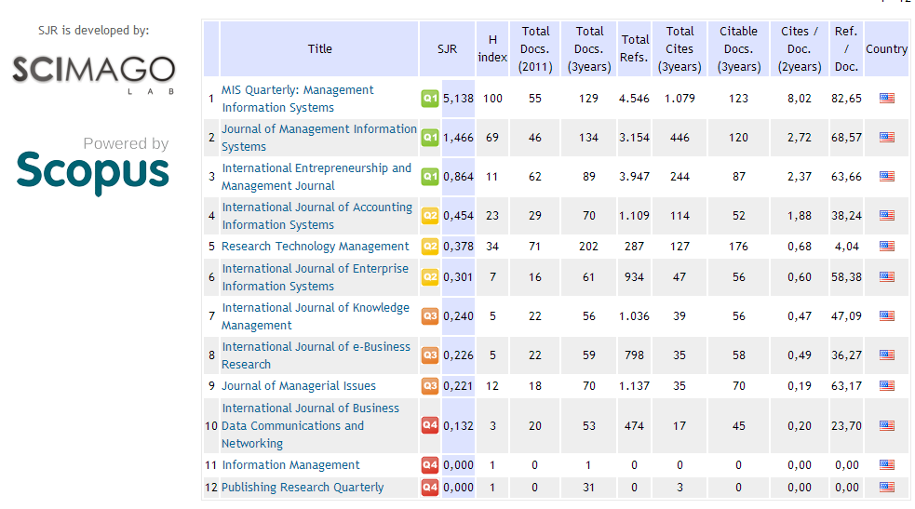
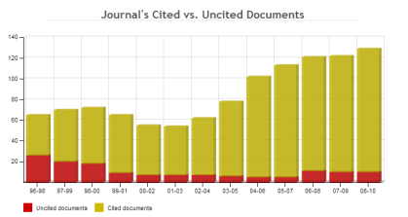
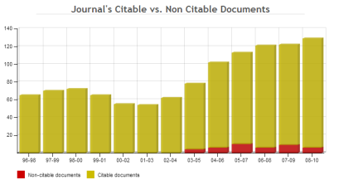
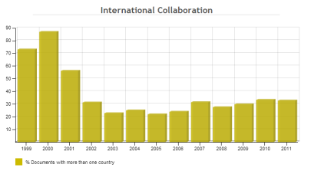
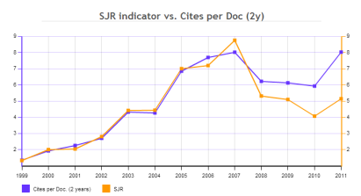
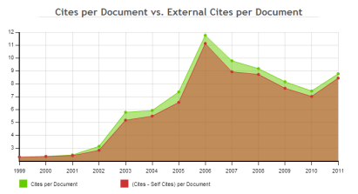
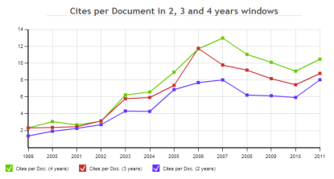
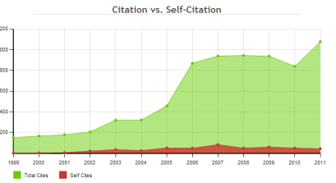
SCImago Journal Rank http://www.scimagojr.com/index.php
Shows the visibility of journals in Scopus.
MIS Quarterly: Management Information Systems

Slide 36
Some words of caution
Impact factor is a journal metric and should not be used to assess an individual researcher
A journal can adopt editorial policies that increase its impact factor
Journal ranking lists based on the impact factor only moderately correlate with journal ranking lists based on the results of an expert survey

Slide 37
Digital and Open Publishing
Academic Publishing
(Journals and Books)
Digital
Hard
Copy
Self Publish
Publisher
Paid
Open
Paid
Open
Paid

Slide 38
Open and self publishing
Does not lack intellectual integrity
Self publishing;
Can involve open peer-review
Good for interdisciplinary subjects
Does not contribute to research ratings
Cannot be relied on for career development
Access correlates more closely with impact than peer review does
Hard copy journals;
Long lead time
Expensive
Few readers
Open access journals are gaining reputations
Sites for self publishing books and addressing the ‘long tail’ market;
Unbound
Blurb
Kickstarter
Academic Publishing
(Journals and Books)
Digital
Hard
Copy
Self Publish
Publisher
Open
Paid
Open
Paid
Paid
The Digital Scholar: How Technology Is Transforming Scholarly Practice

Slide 39
Writing tips
Focus the title accurately on the main topic
Provide a lead in that informs the reader why they should read your manuscript
Provide some sentences that emphasize the main point
Write each paragraph so that it focuses on one point
Make logical transitions between paragraphs
Give references to evidence; facts, examples, statistics
Adhere to linear logic
Present your argument in a way that follows your discipline’s conventions
Use visual representations of date
Be clear, precise, consistent

Slide 40
Plagiarism
Taking someone else’s work as your own
Not providing appropriate citation information to indicate authorship correctly.
Plagiarism is a serious offence
An author who plagiarises is likely to find that;
his/her article is automatically rejected
irrespective of the quality of the work done
he/she is blacklisted from that journal (and other journals) in the future
Plagiarism is very easy to detect
From Davison, R.M. (2011) Tutorial on Publishing ICT4D Research, Presented at the IFIP WG9.4 Conference, Kathmandu, Nepal, 22-25 May.

Slide 41
Quiz 3
True or False

Slide 42
Journal ranking lists based on the impact factor correlate strongly with lists based on expert surveys
False. Journal ranking lists based on the impact factor only moderately correlate with journal ranking lists based on the results of an expert survey
Books get more citations than journals
False
Open publishing is always free to the reader
True
Open publishing lacks intellectual integrity
False. It can.
Journals can adopt editorial policies that increase their impact factor
True.

Slide 43
JCR – Web of Knowledge provides data to evaluate and compare journals
True.
The impact factor of an academic journal is a measure of the number of subscribers it receives each year.
False. It is a measure of the average number of citations to recent articles published in the journal.
The impact factor is a measure of an individual researcher’s work.
False. It is a journal metric and should not be used to assess an individual researcher
Plagiarism is very easy to detect
True.
Scopus provides journal ranking lists
False. Scopus is a bibliographic database containing abstracts and citations

